Slide 1
Climate-ready fisheries management in the California Dungeness crab fishery

Slide 2
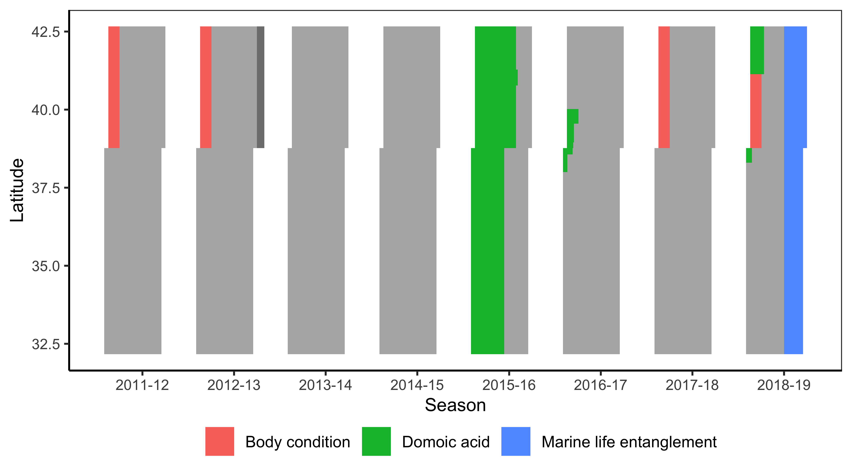
The problem

Slide 3
Current and alternative management strategies
Management measure | Current | Alternate
Domoic acid
Pre-season sampling | 6 areas, 2 locations | More locations
Mid-season sampling | Ad-hoc sampling | Routine sampling
Management action | Space-time closure | Evisceration order
Whale entanglement
Risk assessment frequency | 4x | 12x
Risk assessment framework | 4 indicators of elevated risk | 4 indicators of elevated risk (more precautionary)
Management action | Space-time closure | Space-time closure
Notes:
I’

Slide 4
Fleet dynamics
Biophysical processes
Monitoring programs
Management procedures
Harmful algal blooms (HABs)
Pier HAB monitoring
HAB and domoic acid monitoring
Space-time closures or evisceration
Bivalve monitoring
Contamination
Fishing
Dungeness
crabs
Viscera sampling
Sex-size-season (SSS) system
Targeted capture
Aerial + shipboard surveys
Incidental take through entanglement
Humpback whales
Whale and entanglement monitoring
Space-time closures
Entangle-ment
reports
Frequency, duration, and toxicity driven by ocean conditions
Abundance and distribution driven by oceans and forage fish
Forage fish (krill and anchovies)
Surveys and stock assessments
Risk Assessment and Mitigation Program (RAMP)
Oceans
Ocean observation programs

Slide 5
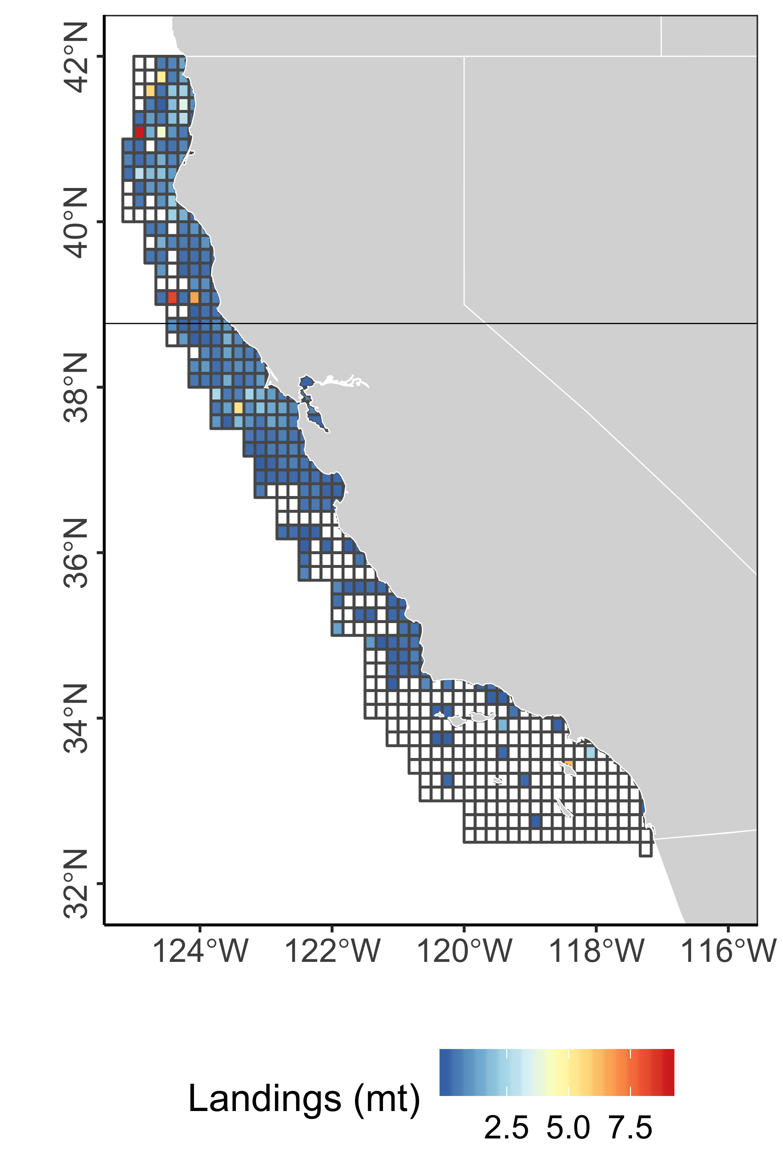
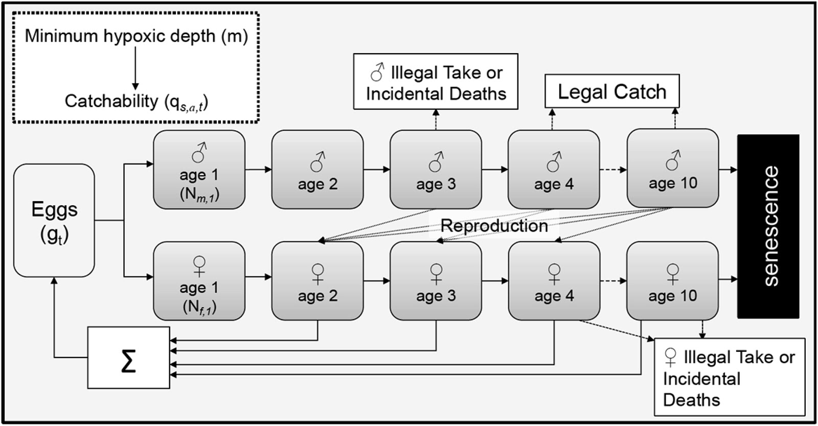
1. Population dynamics model
An age- and sex-structured population dynamics model spatially organized by CA commercial fishing blocks, operating on weekly time steps from March 2014 to July 2019, and based on Froehlich et al. 2017.
A) Spatial dynamics
B) Age- and sex-structured dynamics
Froehlich et al. 2017

Slide 6
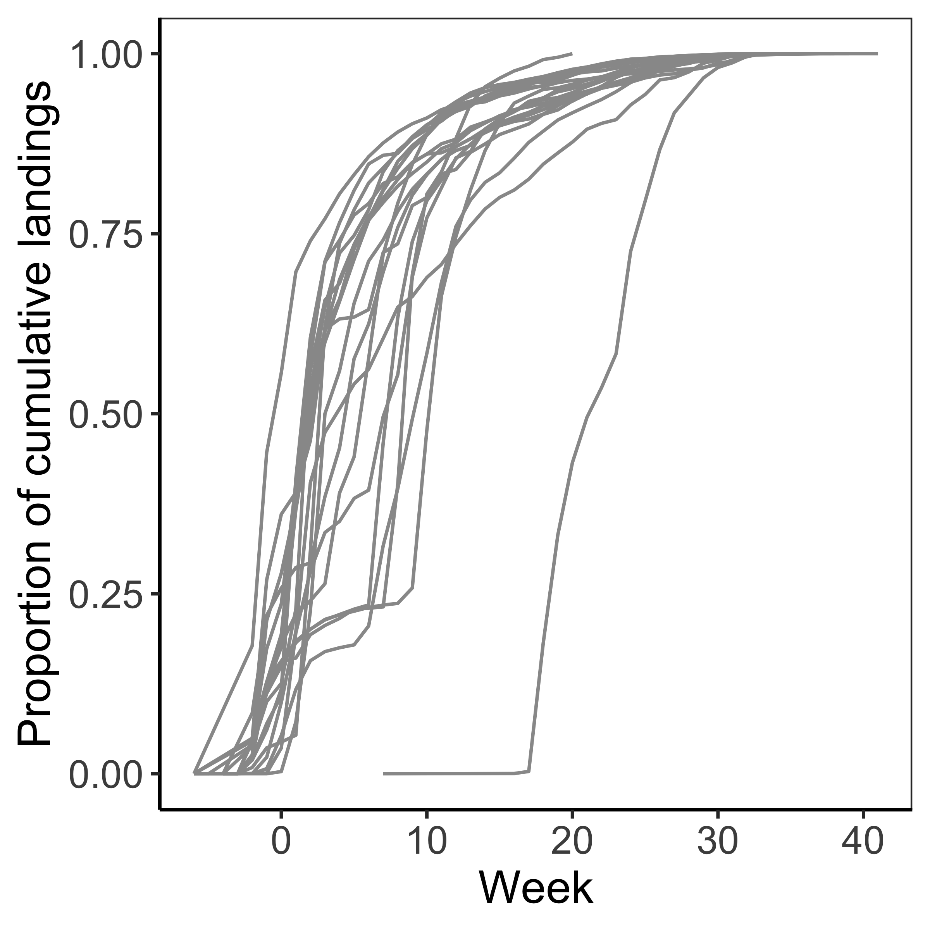
2. Effort dynamics model
A model of spatial-temporal fishing dynamics based on either (1) Owen Liu and Jameal Samhouri’s fleet dynamics model or (2) based on an open access fishing model tuned to CDFW landings data.
A) Spatial dynamics
B) Temporal dynamics

Slide 7
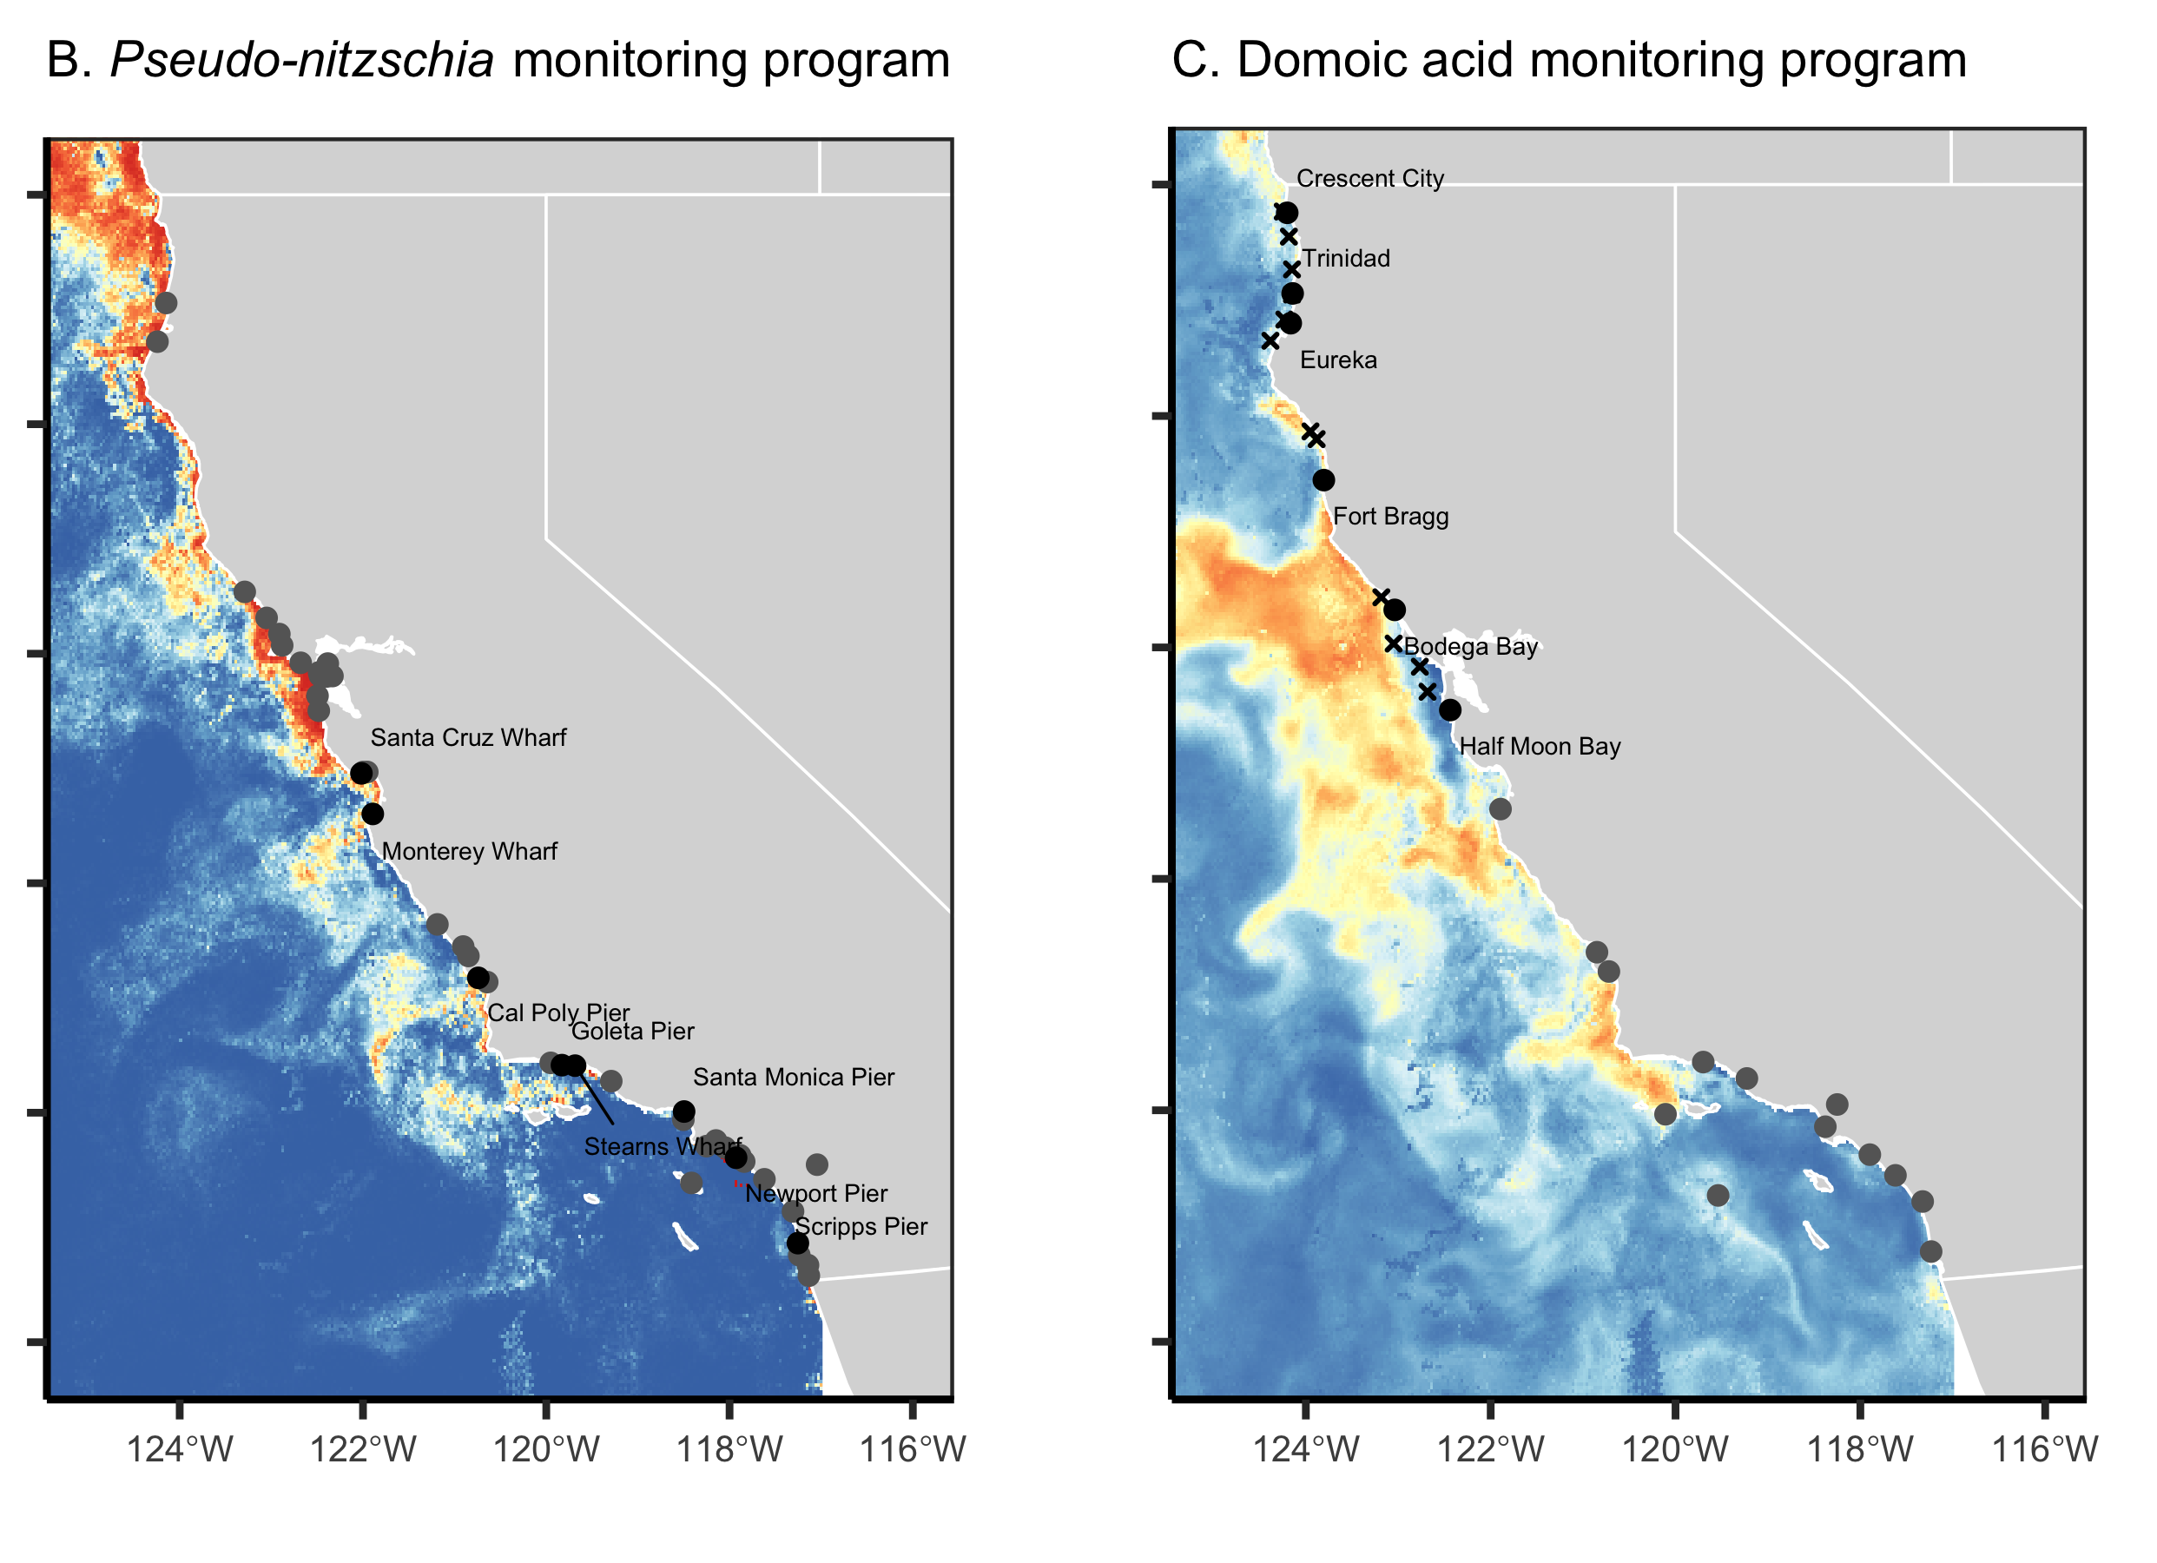
3. Domoic acid contamination model
We model the contamination of Dungeness crabs with domoic acid using CDPH viscera contamination data and predictions of high particulate domoic acid risk from C-HARM (Anderson et al. 2016).
We also simulated the monitoring of the following indicators of elevated domoic acid risk using CHARM and CDPH field observations:
Bivalve contamination
Pier-monitoring of
Notes:
What are the

Slide 8
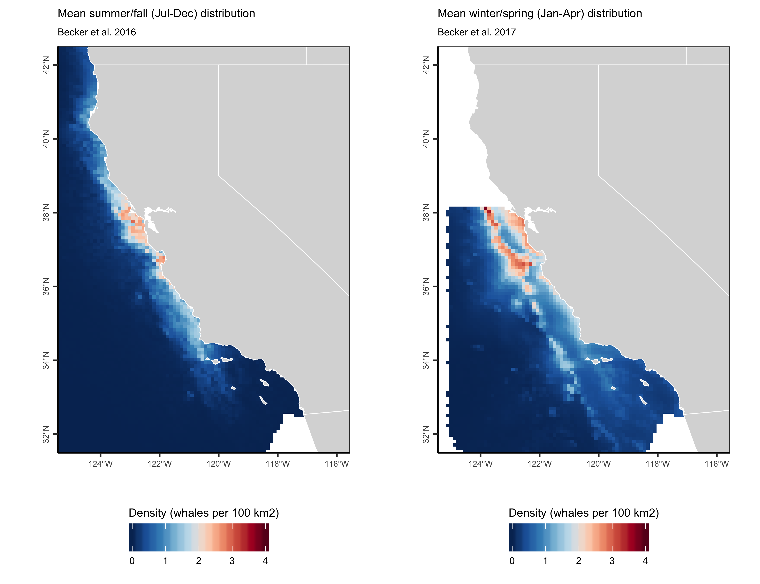
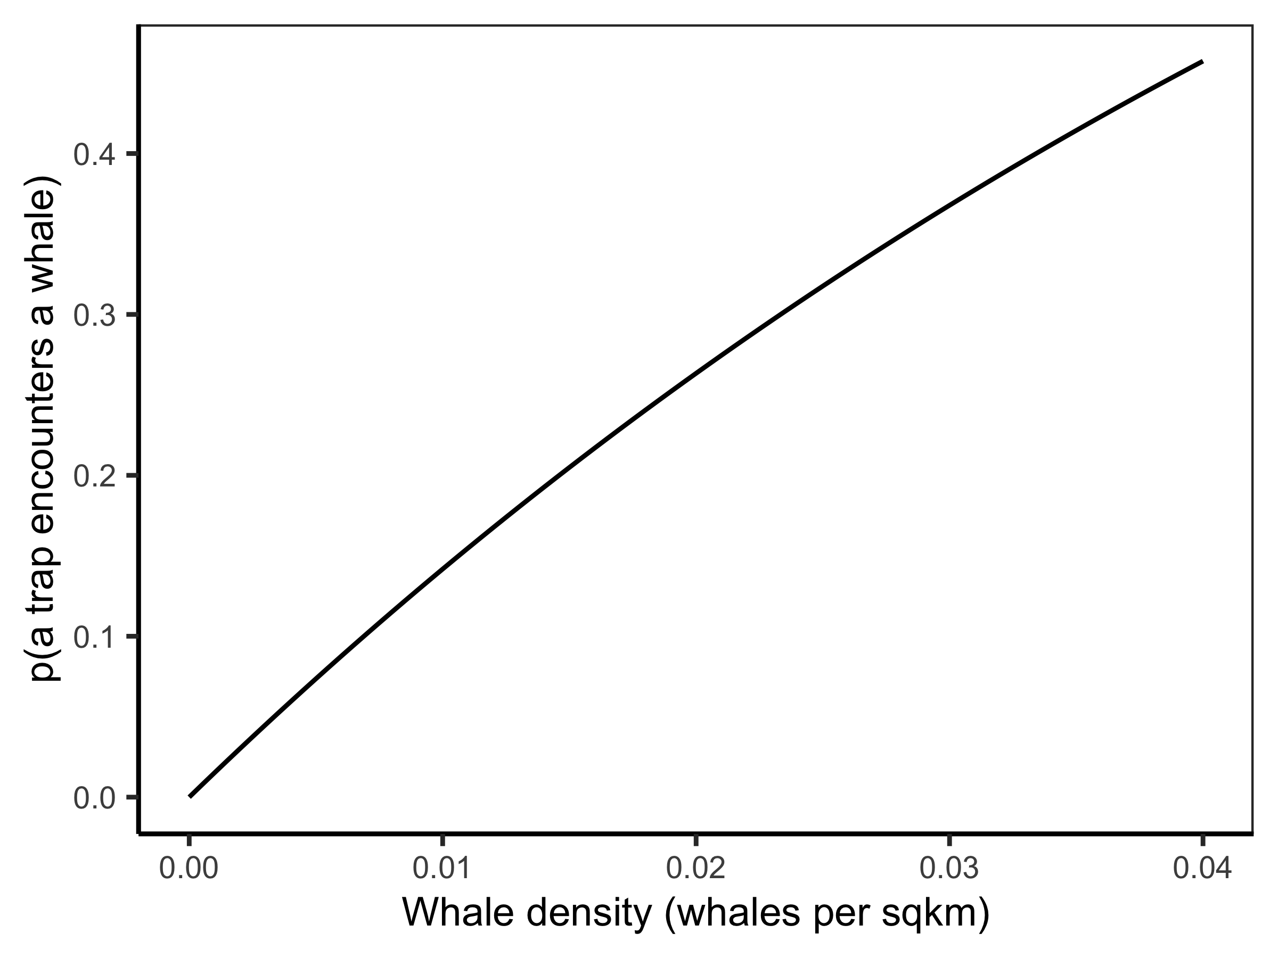
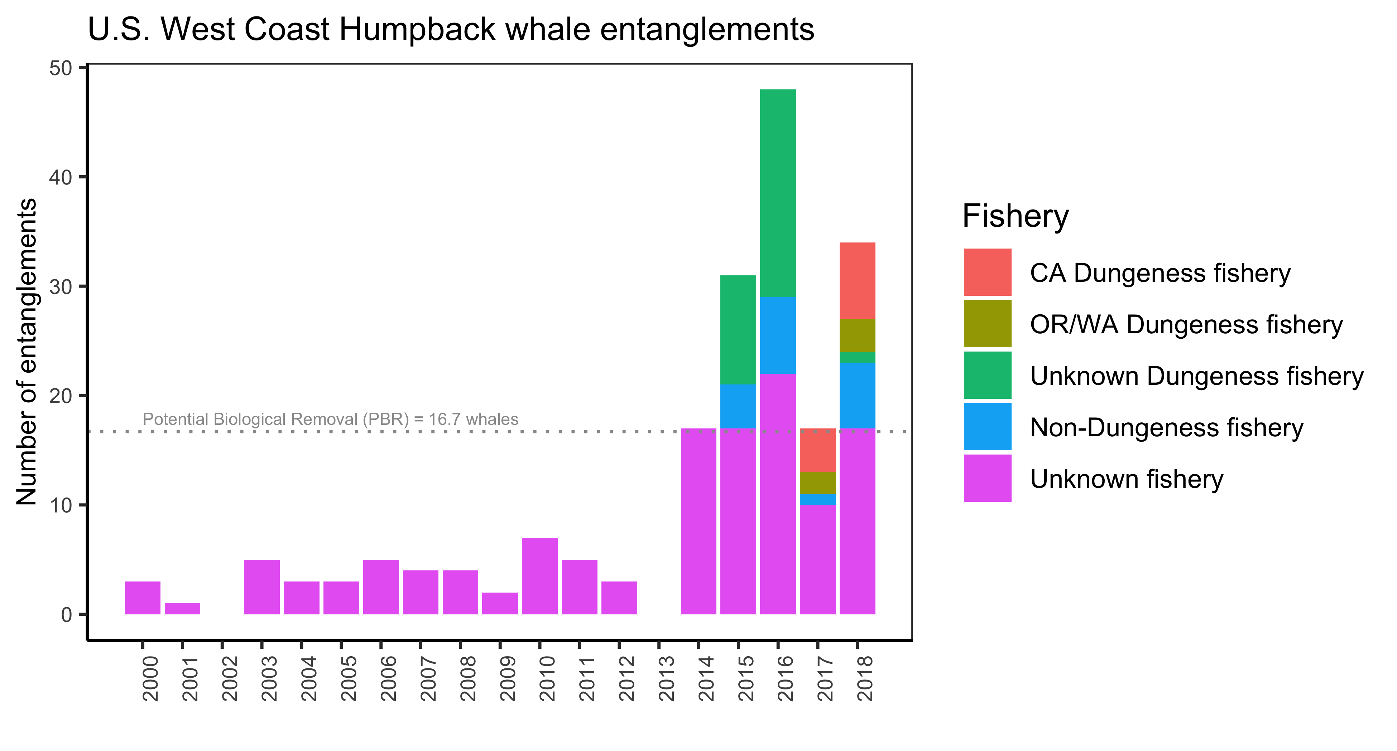
4. Whale entanglement model
We propose to simulate the density of humpback whales using the Forney et al. (in prep) species distribution model. We derive the probability that a whale encounters a trap using ideal gas theory and tune the probability that a whale becomes entangled in an encounter trap to historical rates of entanglement.
Step 1. Whale density
Step 2. Probability that a whale encounter a trap
Step 3. Probability that a whale becomes entangled in an encountered trap
Becker et al. 2016

Slide 9
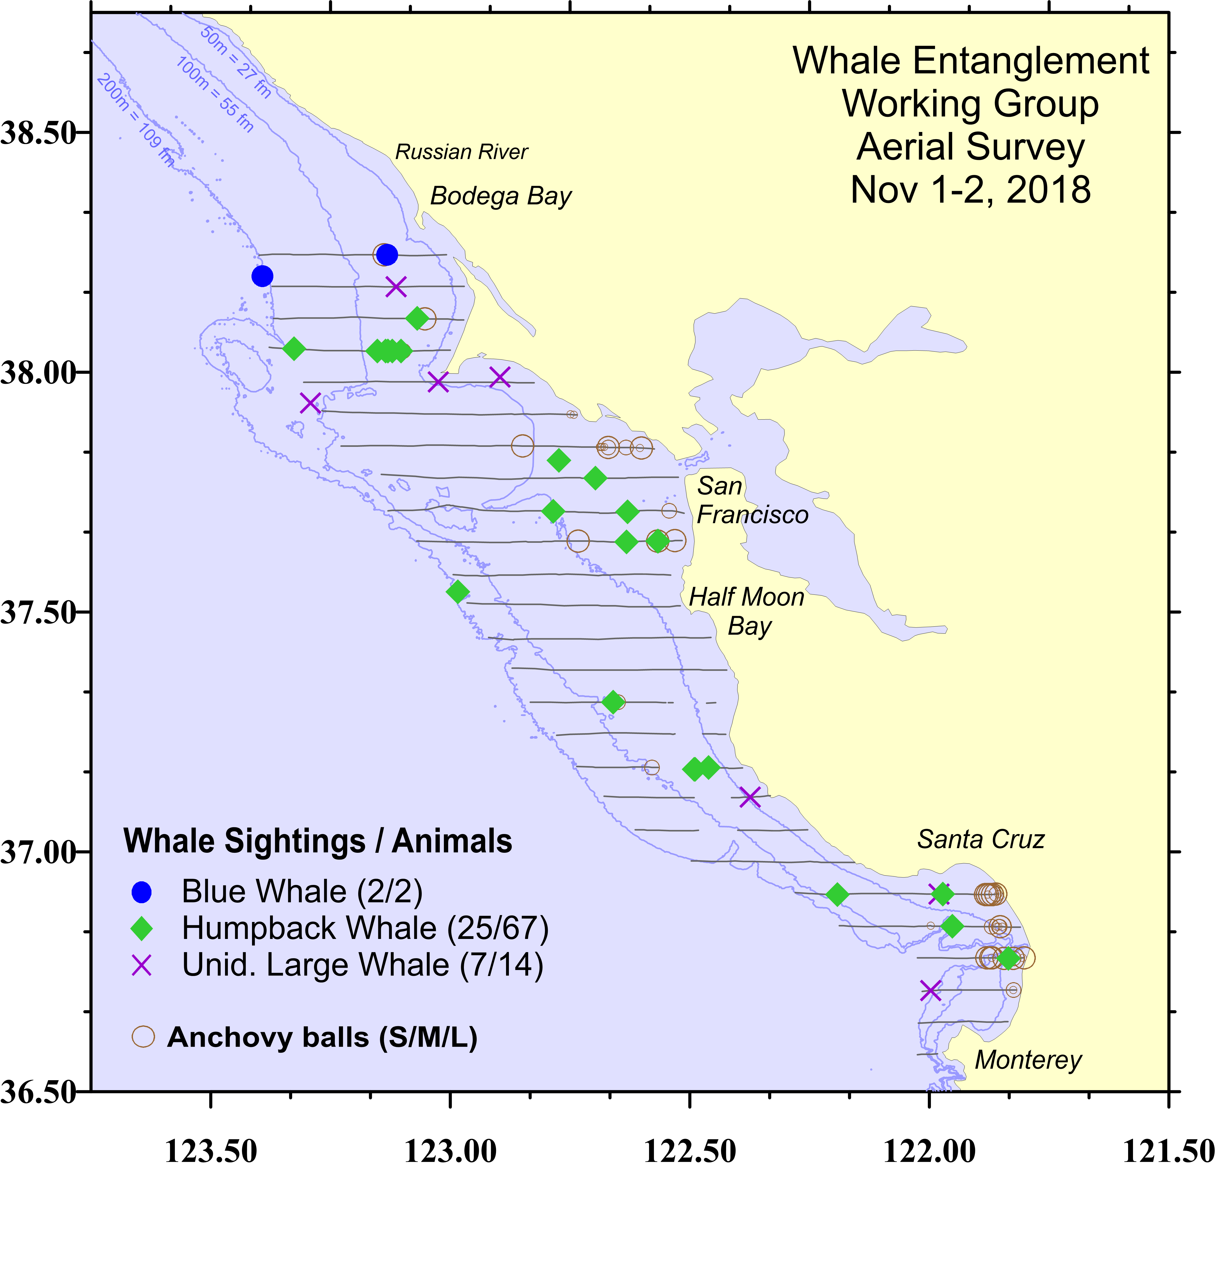
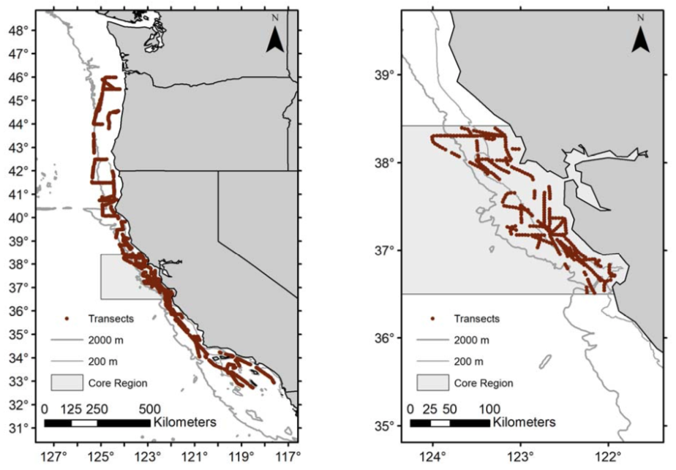
5. Simulating the RAMP framework
Indicator #1: Presence of species of concern
>20 whales in a single survey or average of >5 whales over one week of a survey
“Fall aerial marine mammal survey”
Forney, personal communication
“Spring shipboard rockfish survey”
Sakuma 2017
Full region
37 days
87 humpbacks
Core region
18 days
17 humpbacks

